Slide 1
Cloud Native Data Flow Orchestration
Mark Fisher | Patrick Peralta
@m_f_ | @patrickperalta

Slide 2
Overview
Streaming and Batching with Spring XD
From modules to microservices
Orchestration by Spring Cloud Data Flow
Demos
Local
YARN
Lattice
Cloud Foundry

Slide 3
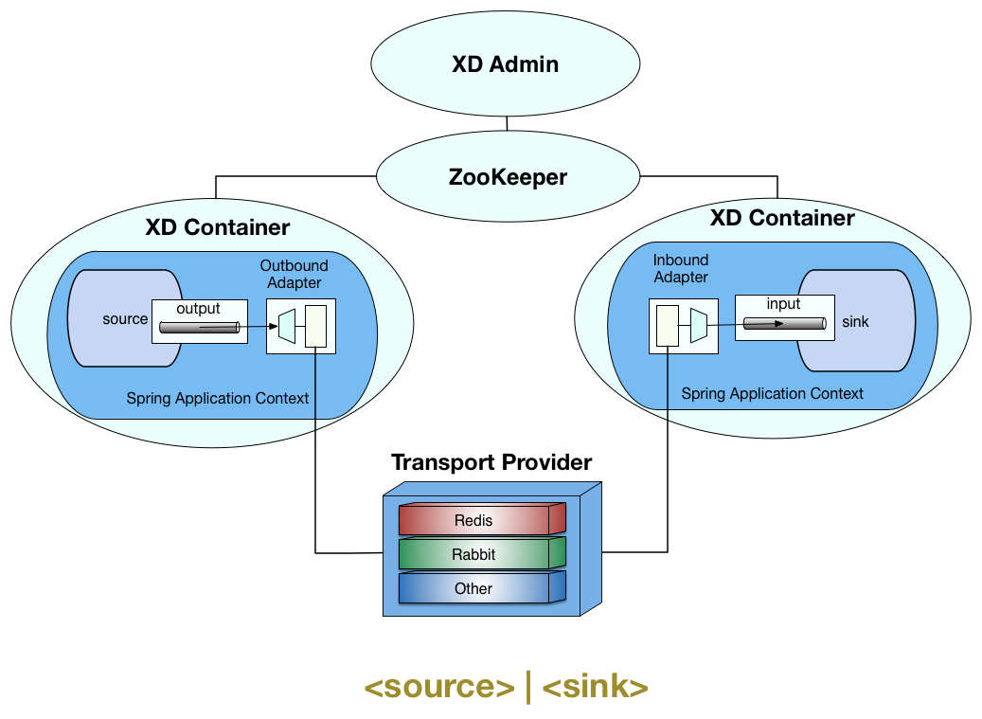
Streaming and Batching with Spring XD

Slide 4
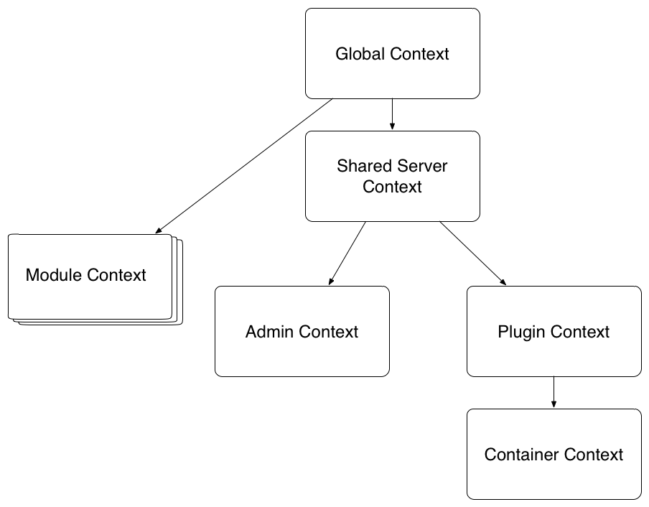
Spring XD Modules
Execute inside of a Spring XD Container
Consist of beans in an application context
Multiple modules may run in a container, each with their own class loader

Slide 5
Room For Improvement
Custom module development was somewhat complex
Classloader issues, jar proliferation in the lib directory
Feature requests for a more dynamic distributed runtime (scale up, down)
From | To
Modules | Microservices
Built in distributed runtime | Distributed runtime SPI (Cloud Foundry, Lattice, YARN)

Slide 6
STOP! Download Fonts Now.
PLEASE DOWNLOAD AND INSTALL THESE FONTS BEFORE CREATING YOUR PRESENTATION. You can download the fonts here…
https://www.dropbox.com/s/na8jewnsp8dp659/SpringOne-2015-Fonts.zip?dl=0
Fonts included in the ZIP file:
Proxima Nova (body text)
Domine (headlines)
http://www.fontspring.com/support/installing/how-do-i-install-fonts-on-my-mac
http://www.fontspring.com/support/installing/how-do-i-install-fonts-on-my-windows-pc

Slide 7
Contents
Title slide
Contents
Using this template
Intro
Inserting slide & applying layout
Layouts
Fonts
Colors
Code Slide
Call to Action Slide
Safe Harbor Statement
Logos and clip art
Logos
Event logos and icons
Project icons
Tool suite icons
General icons
Table and Charts
Pie chart
Bar chart
Line chart
Table

Slide 8
USING THIS TEMPLATE

Slide 9
Intro
This template has been carefully prepared with specific layouts, colors, fonts and more. This short intro will outline the basic components of this template.
Note: This template includes slides with approved color palette, fonts, logos and clip art. It’s a good idea to keep these slides in order to quickly access these assets then delete the slides when you have finished creating your presentation.

Slide 10
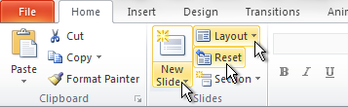
Inserting New Slides and Applying Layouts
To create different types of slides, select New Slide and apply desired Layout
If you make formatting changes to a slide and want to reapply the default settings, click Reset

Slide 11
Layouts
There are 13 layouts
Title Only – Standard slide with no text content box, do not use for section title
Title and Content (1 Col) – Standard slide with title and text content box
Title and Content (2 Col) – Standard slide with title and two text content boxes
Comparison – Standard slide with title and two text content boxes with subtitles
Section Title – Use between sections
No text
Table – Quick and easy way to get a table with brand colors
Bar Chart – Quick and easy way to get a bar chart with brand colors
Line Chart – Quick and easy way to get a line chart with brand colors
Pie Chart – Quick and easy way to get a pie chart with brand colors
Code Formatting – Quick and easy way to get preferred code formatting
Title Slide – Presentation title with author name and contact info. Use only once in presentation.
Completely blank – A totally blank, white slide. Use sparingly.

Slide 12

Title Proxima Nova Bold (30pt)
All body text is Proxima Nova Regular
Subhead (18pt)
Level Two (18pt)
Level Three (18pt)
Level Four (18pt)
Use the “Decrease/Increase Indent” tools to change bullet levels
Click on the Home ribbon, Paragraph tab
Line spacing is set in master slides

Slide 13
Brand Colors
SpringOne 2GX 2015
Theme Colors
Spring
Brand Colors
R: 12
G: 48
B: 100
R: 156
G: 209
B: 121
R: 83
G: 83
B: 83
R: 109
G: 179
B: 63
R: 38
G: 97
B: 168
R: 204
G: 204
B: 204
R: 241
G: 241
B: 241
R: 153
G: 153
B: 153
R: 52
G: 48
B: 45
R: 114
G: 163
B: 211

Slide 14
Code Slide
// This is Arial: 18 pt or higher please
public class TransferServiceImpl implements TransferService {
public TransferServiceImpl(AccountRepository ar) {
this.accountRepository = ar;
}
…
}

Slide 15



Learn More. Stay Connected.
@springcentral
Spring.io/video
<Your CTA>
<Related Session>

Slide 16
Safe Harbor Statement
If you are a pivotal employee and your talk contains forward facing information, please include this slide at the beginning or conclusion of the presentation.
Remove this text box before presenting.
The following is intended to outline the general direction of Pivotal's offerings. It is intended for information purposes only and may not be incorporated into any contract. Any information regarding pre-release of Pivotal offerings, future updates or other planned modifications is subject to ongoing evaluation by Pivotal and is subject to change. This information is provided without warranty or any kind, express or implied, and is not a commitment to deliver any material, code, or functionality, and should not be relied upon in making purchasing decisions regarding Pivotal's offerings. These purchasing decisions should only be based on features currently available. The development, release, and timing of any features or functionality described for Pivotal's offerings in this presentation remain at the sole discretion of Pivotal. Pivotal has no obligation to update forward looking information in this presentation.

Slide 17
LOGOS & ICONS

Slide 18






Logos

Slide 19





Event Logos and Icons
Logo on dark
Logo on light
Date logo on dark
Date logo on light

Slide 20


















Spring Project Icons
Spring
Framework
Spring
Security
Spring
Data
Spring
Batch
Spring
Integration
Spring
Reactor
Spring
AMQP
Spring
Hateoas
Spring
Mobile
Spring
Android
Spring
Social
Groovy
Spring
Web Services
Spring
Web Flow
Spring
XD
Spring
Boot
Spring
LDAP
Grails
PNG and PSD files for all Spring projects can be found here…
https://www.dropbox.com/sh/5rbbt8v6evvm7xm/AAAZmhgf0zglGHZUWYhPvojFa?dl=0

Slide 21




Spring Tool Suite Icons
Spring Tool Suite
Groovy / Grails Tool Suite

Slide 22












Spring Document Icons
Spring Framework
Support
Tools
Guides
Tutorials
Reference App

Slide 23



















Additional Spring Icons
Continuous
Integration
Issues
Metrics
Forums /
Discussion
Blog
@
All
Author
Broadcast
Date
Engineering
News
Event
Releases
Apple
Linux
Windows
Professional
Support
Community
Support
Location

Slide 24



























Icon Guidelines
These icons can be used when Spring icons are not appropriate.
Max icon size is 2.08 inches – anything larger and the icon will be blurry
Icons are transparent and can be placed over images and other objects
To use an icon, simply choose, copy and paste
200x200 PNG files can be found here… https://www.dropbox.com/sh/wy65b4l5t4fv9b4/AAD1LMHcOtwJSTbNu23zqywka?dl=0
Max icon size:
2.08 inches

Slide 25

















































































































































Slide 26

















































































































































Slide 27
CHARTS & TABLES

Slide 28
Sample Pie Chart

Slide 29
Sample Bar Chart

Slide 30
Sample Line Chart

Slide 31
Sample Table
 | 2007 | 2008 | 2009 | 2010
Category 1 | 2.4 | 6.4 | 4.1 | 6.6
Category 2 | 8.2 | 4.5 | 3.2 | 3.8
Category 3 | 4.6 | 3.2 | 1.9 | 9.6
Category 4 | 6.7 | 3.3 | 3.4 | 2.2
Category 5 | 4.3 | 5.6 | 7.1 | 3.4

